Slide 1
CSS Box Model Lab Question

Slide 2
Lab Question 1
Download the zipped file from Moodle, this file is named CSS Box Model Lab 1.zip
Extract this file into this weeks folder
All the files you need are in this folder, you do not need to create any new files
All that is required from you in this lab is to modify the main3.css file located in the CSS folder.
Use the notes and of course the W3C school to complete this lab
The html file is already linked to the CSS file.
The HTML file without any css can be seen on slide 3
The final result, can be seen on slide 4.
Make sure to save and test your work regularly

Slide 3
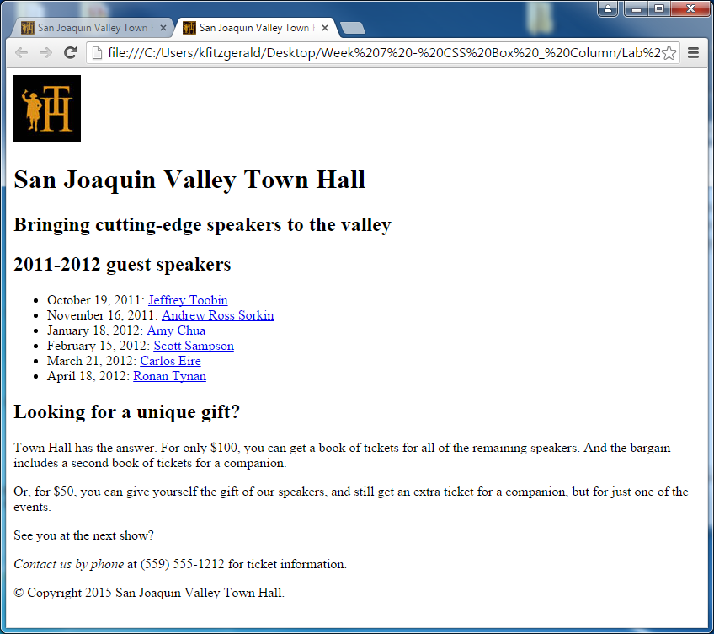

Slide 4
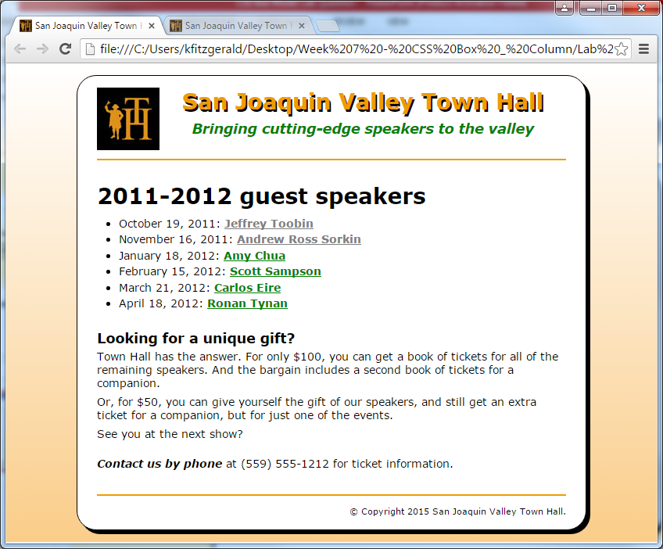

Slide 5
Lab Question 2
On Moodle, download the HTML file named PhoenixTemplate.html
In your CSS folder create a CSS file called phoenixLike.css
Style the HTML page so that it looks like the page illustrated on slide 6
When you have completed this, make a copy of the css file and save it as phoenixLike2.css
Link the HTML page to this new css file
Modify phoenixLike2.css so that the page looks like that as illustrated on slide 7

Slide 6
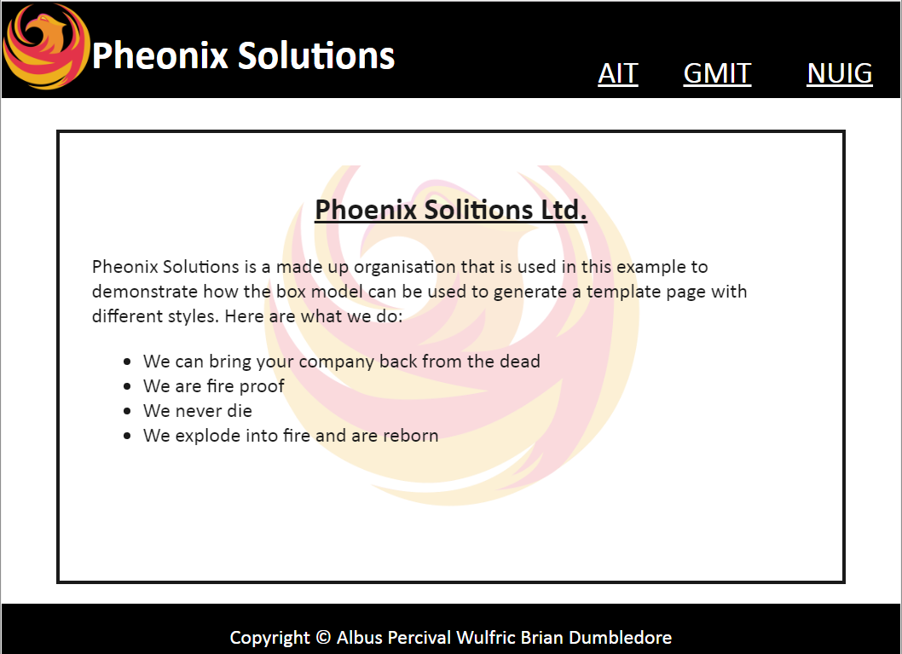

Slide 7
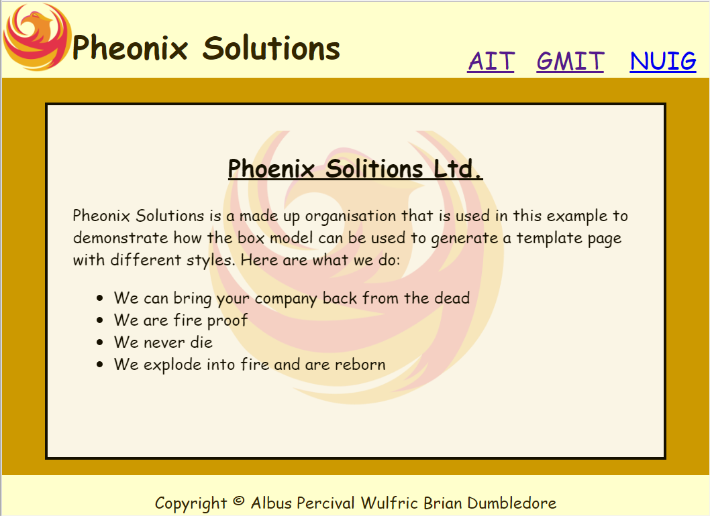

Slide 8
Lab Question 3
Download and extract the zip folder called XHTML_HTML5_DIV
Inside this folder there are two html files, one is a XHTML and the other is HTML5
The objective of this exercise is to modify the CSS file only where the code is commented out /*Place your code here*/ to get both pages to look like that on the following slide
Do not modify the HTML or XHTML document
Only modify the CSS between the brackets where the code is commented out.

Slide 9
